Slide 1
Accountability to Affected People – Taking Account, Giving Account and Being Held to Account – Buzzwords or Benefits for People in Crises? Practical Lessons from Field Operations
Welcome to the webinar!
Make sure you are connected to the audio:
Click on the box with the headphones icon for “Call Using Computer”.
If you don’t immediately see the Audio Connection box in front of you, go to the Quick Start tab and find it there.
If your computer audio is not working during the event, you can also listen by phone instead.
Dial +1-650-429-3300 or find the global call-in number for your location at: www.humanitarianresponse.info/system/files/documents/files/Webex%20Global%20call-in%20numbers.pdf
Access code: 641 664 125
In case you are unable to connect to the event, a non-interactive live stream is available at YouTube: www.youtube.com/watch?v=aFYxtgZ6ISA
All webinar recordings are available on the website: www.humanitarianresponse.info/topics/transformative-agenda
The webinar will start at 14:00 UTC (09:00 Bogota/ 10:00 Port-au-Prince, New York/ 14:00 Dakar/ 16:00 Geneva / 17:00 Amman, Juba)

Slide 2
Speakers
Facilitator
Panos Moumtzis Director, IASC Senior Transformative Agenda Implementation Team (STAIT)

Slide 3
To be incorporated into agencies policies and operations
To be promoted with partners, Humanitarian Country teams and clusters
To be reported back against
5 Commitments :
Leadership/Governance
Transparency
Feedback & Complaints
Participation
Design, Monitoring & Evaluation
Operational framework
Tools

Slide 4
What have the IASC Principals done to advance Accountability to Affected People in humanitarian operations? What is the vision of the IASC AAP Champion and what changes would you like to see ?

Slide 5
How has Accountability to Affected People been incorporated into humanitarian response in South Sudan? What difference has it made to affected people?

Slide 6
What are the different components of accountability? What does AAP mean in practical terms?

Slide 7
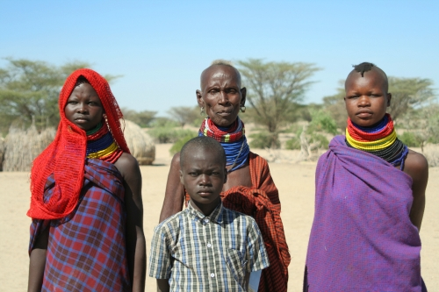
Giving affected people influence over decision-making in a way that accounts for the diversity of communities, and allows the views of the most vulnerable/at-risk to be equally considered
Intervention strategies based on the needs and priorities of affected populations, not capacities of agencies
Individual / collective feedback mechanism
Taking
Account
”Closing the loop” : Systems able to adapt to collected feedback and modify programs accordingly, and report back to affected population
Individual/ Collective Complaints mechanism
Astrid de Valon Ethiopia 2010
Transparency and effectively sharing information with communities
Participatory monitoring and evaluation
Prevention of sexual exploitation and abuse
Being Held
to Account
Giving
Account
Communication with Communities
Giving others the opportunity to assess and, if appropriate, sanction your actions
Transparent cluster decisions
Accessible formats
Transparent beneficiary selection criteria
Information on services/assistance

Slide 8
Are crisis-affected people’s views, including those of the most vulnerable or at-risk, sought and used to guide programme design and implementation?
Are programmes adapted to respond to priorities articulated by the community?
Do all groups within affected communities and individuals feel they have equal opportunities to participate in decisions about the actions that affect them? Are barriers to giving feedback identified and addressed?
Taking
Account
Is information about the organization and response provided in accessible and appropriate ways to affected communities and people?
Are people, especially vulnerable and at-risk groups, accessing and understanding the information provided?
Are our systems, like the Humanitarian Programme Cycle, supportive of our commitments on accountability to affected population ?
Astrid de Valon Ethiopia 2010
Being Held
to Account
Giving
Account
Are communities and people affected by the crisis consulted about the design of complaints mechanisms?
Are monitoring, evaluation, feedback and complaints-handling processes leading to changes and/or innovations in programme design and implementation?
Are there specific policies and procedures in place to deal with situations of sexual exploitation, abuse or discrimination? Are they known to staff?
Notes:
Here are a few questions you agencies and country teams can ask themselves, as a self assessment of how they are actually taking account, giving account and being held into account.

Slide 9
What’s the difference between AAP on a collective and an individual level? What’s an example of a collective accountability mechanism?
1. Individual agencies collect community feedback 2. All individual agency feedback is compiled into consolidated feedback through hubs in relevant districts 3. Consolidated feedback is analysed for key theme issues across agencies 4. Key theme issues are shared with relevant cluster and inter-cluster group at hub level 5. All themes across hubs are shared with relevant clusters and inter-cluster at the national level - and with Humanitarian Country Team (HCT) on relevant issues.

Slide 10
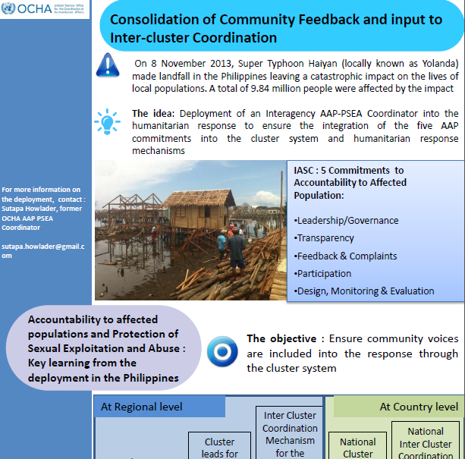
Resource document available at www.humanitarianresponse.info/en/topics/transformative-agenda/document/accountability-affected-populations-and-protection-sexual

Slide 11
“Uwajibikaji Pamoja” – How it works...
People
Walks in/ Gets tracking number
Sends SMS/Submit online – gets tracking number
Notified of update
Service Provider A
SProvider B
Receive update
Notified of complaint/Acknowledge receipt
Update case/resolve
Submit referral/Receive Tracking number
Prompt if no action has been taken
Complaints Referral System
Law
Enforcement Agencies
Oversight Institutions
Generate Reports/Data
Report
Notified of update
Notified of complaint
Convenor
County Authorities

Slide 12
Who is responsible for AAP? What are the roles and responsibilities of different actors?

Slide 13
Where can I get help?
helpdesk-aap-psea@unhcr.org

Slide 14
Background documents:
Accountability to Affected Populations - The Operational Framework (IASC Transformative Agenda Protocol)
Preventing Corruption in Humanitarian Operations - A Handbook of Good Practices (Transparency International, 2010)
Food Assistance Integrity Study, Analysis of the 2011 Drought response in Kenya (Transparency International, 2012)
The Good Enough Guide: Impact Measurement and Accountability in Emergencies (Emergency Capacity Building Project)
Lessons from Haiyan: five steps to improve accountability to affected people
Accountability to affected populations and Protection of Sexual Exploitation and Abuse: Key learning from Typhoon Haiyan response in the Philippines
Collective feedback Mechanism for beneficiaries of The Somalia Return Consortium
The 3 Components of Accountability to Affected People – Working DRAFT April 2015
Proposition Paper for the World Humanitarian Summit: Enhancing Community Engagement during Humanitarian Response (April 2015)
These can be found at: www.humanitarianresponse.info/topics/transformative-agenda/event/webinar-accountability-affected-people-taking-account-giving

