Slide 1


Preparedness
Can we learn from the Nepal earthquake response?
Does preparedness work? How does it work? Are we doing it right?
Welcome to the webinar!
Make sure you are connected to the audio:
  Click on the box with the headphones icon for “Call Using Computer”.
  If you don’t immediately see the Audio Connection box in front of you, go to the Quick Start tab and find it there.
If your computer audio is not working during the event, you can also listen by phone instead.
Dial +1-650-429-3300 or find the global call-in number for your location at: www.humanitarianresponse.info/system/files/documents/files/Webex%20Global%20call-in%20numbers.pdf
Access code: 649 421 288
In case you are unable to connect to the event, a non-interactive live stream is available as a back-up at www.youtube.com/watch?v=BRBHrZ_5z5k
All webinar recordings are available on the website: www.humanitarianresponse.info/topics/transformative-agenda
First webinar will start at 10:00, Geneva-time
Second webinar will start at 15:00, Geneva-time

Slide 2
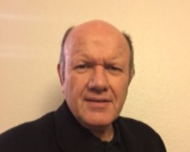
Co-Chair IASC Task Team on Preparedness and Resilience
Preparedness in the IASC

Slide 3
IASC Preparedness Bodies
Pre 2014 – SWG on Preparedness
2014-2015 Task Team on Preparedness and Resilience
2016 >Reference Group on (Risk), Early Warning and Preparedness
Notes:
Preparation
Make sure everyone has a selection of colored cards, a marker, and sticky tape
If possible use a wall where participants can stick their finished cards, if not they can stick their cards on the flip charts
Facilitator Notes:
Explain that this is an individual rather than a group exercise and is designed to provide time for some self reflection.
Ask the audience to think about the question on the slide and using the card write down one element per card (they can identify as many elements as they want in the time allotted.
Debrief
Move all groups standing facing the wall/flip charts. Run through what’s on the wall and ask if they agree or if there are other elements they would add. (Note: you should try and generate further discussion and ideas during the debrief )
Segway
At the end of discussion highlight that what the group has identified is pretty much the elements of the ERP that we are going on to discuss.
Note that this was how the ERP was designed i.e. we looked at a what made a good response and worked backwards albeit it took three years!
Highlight that we will refer to this exercise through out the training and specifically when we unpack the MPAs
Before moving on to the next slide leave the participants with the following mantra:
If in doubt think response
(in other words if you are implementing the ERP and are unsure what you should include ask yourself if it will add value to response)

Slide 4
Lines of Work
Operational
  Early Warning Reports (Anticipate, do not wait)
Norms and Technical
  IASC Readiness (Retain Emergency Capacity)
    Emergency Response Preparedness (ERP)
    Simulation methodology
    Making the case
  IASC Support to Others (Reinforce, do not replace)
  Transcend Humanitarian-Development Divides)
    Common Framework on Preparedness
  Linking the two (as local as possible – as international as necessary)
Notes:
Preparation
Make sure everyone has a selection of colored cards, a marker, and sticky tape
If possible use a wall where participants can stick their finished cards, if not they can stick their cards on the flip charts
Facilitator Notes:
Explain that this is an individual rather than a group exercise and is designed to provide time for some self reflection.
Ask the audience to think about the question on the slide and using the card write down one element per card (they can identify as many elements as they want in the time allotted.
Debrief
Move all groups standing facing the wall/flip charts. Run through what’s on the wall and ask if they agree or if there are other elements they would add. (Note: you should try and generate further discussion and ideas during the debrief )
Segway
At the end of discussion highlight that what the group has identified is pretty much the elements of the ERP that we are going on to discuss.
Note that this was how the ERP was designed i.e. we looked at a what made a good response and worked backwards albeit it took three years!
Highlight that we will refer to this exercise through out the training and specifically when we unpack the MPAs
Before moving on to the next slide leave the participants with the following mantra:
If in doubt think response
(in other words if you are implementing the ERP and are unsure what you should include ask yourself if it will add value to response)

Slide 5
ERP : overview
Part of Humanitarian Programme Cycle
Understand Risk
All Hazard Minimum Preparedness Actions
Monitor Risk
Manifest Risk – Advanced Preparedness Actions & Contingency Planning
Refugee and IHR Situations

Slide 6
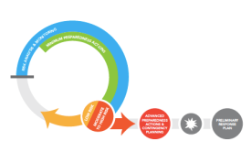

Slide 7
Nepal Grouped Takeaways
The Basics Matter
Savvy Investment
  Coherence
  Familiarity
Notes:
Facilitator Notes:
You should also have a clear understanding of the background of the ERP, the logic and rational behind the ERP, the main goal of the ERP, some of the major game changing elements the ERP hopes to create.
Finally you should be clear on the broad roles and responsibilities, as well as the linkages, between the various actors – RC/HC, HCT, sectors/clusters, local communities, government, etc.

Slide 8
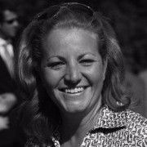
Preparedness: Can we learn from the Nepal Earthquake?
Victoria Stodart
SHELTER CLUSTER COORDINATOR, NEPAL (APRIL & MAY, 2015)

Slide 9
The Shelter Cluster Perspective
Govt lead: DUDBC; co lead IFRC
Over 700,000 homes destroyed or damaged in 14 priority districts
25 April 2015 – 31 Dec 2015: 115 operational agencies provided 635,950 households with shelter and 485,682 HHs with NFIs
Cluster has returned to its preparedness state

Slide 10
Preparedness plans
Active cluster since 2008
Responded to small and medium scale disasters
Regular shelter cluster meetings
Contingency plan
Scenario planning

Slide 11
What worked?
Awareness of the cluster approach and our ‘business’
Pre existing knowledge and relationships
An agreed approach - contingency plan which included contacts, agreed specs, kits and assessment questions

Slide 12
What tested us?
Private sector: both from a market perspective and from capacity to deliver
Cash: inclusion of shelter in the discussion, reporting and build back safer?
Local level coordination and linking to development

Slide 13
Ongoing challenges?
People and money:
  Funding in country for preparedness and investing appropriately in personnel to ensure they remain
  Lack of predictable funding to the global clusters to enable roving capacity to support cluster preparedness and capacity build
Urban…are we really ready? Especially when considering private sector/civil society/municipal coordination as well
  Nepal Shelter Cluster: Private Sector Coordination Pilot Study (www.sheltercluster.org )

Slide 14
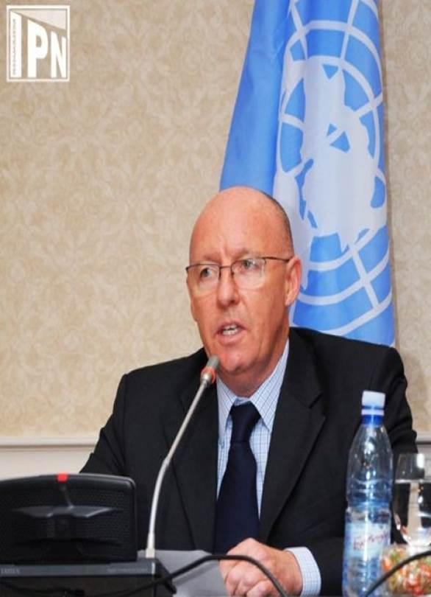
NEPAL PREPAREDNESS CONTEXT
JAMIE MCGOLDRICK,
RC/HC (Yemen), previously RC/HC (Nepal)
Legislation
National Disaster Response Framework
Collective planning: shared responsibilities

Slide 15



Slide 16
HUMANITARIAN / DEVELOPMENT LEARNING AND INVESTMENT
Twenty year development plans
Increased awareness on the part of the national Government
Over 800 harmonized Community Disaster Risk Management Programmes
Nationalised clusters
The Humanitarian Staging Area at the airport

Slide 17


Slide 18
EMERGENCY RESPONSE PREPAREDNESS AND THE HCT
Nepal was a pilot country in Asia for ERP
Trainings and scenarios contributed to good planning and response
Strong OCHA regional support (including ongoing contributions to preparedness)
Protection and gender were central in the response
HCT + and the strong and supportive relationship with donors (small donor group)

Slide 19
NEW WAYS OF WORKING
Contracts with the private sector
On-Site Operations and Coordination Centre included an Assessment Cell: novel arrangement
Communications with Communities project in the RCO: monitoring rumours at the community level; collect regular data from communities (including perceptions)
Working with the scientific community (relationships already established)
Cash

Slide 20
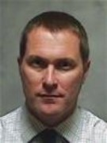
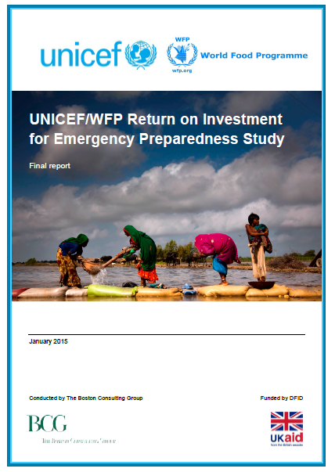
Measuring the benefits of Preparedness
Head of Humanitarian Policy and Partnerships
DFID
Return on Investment
Time and Cost

Slide 21
What are the results / findings?
All investments examined saved significant time and/or costs.
64% saved both costs and time.
Investments made have enabled responses in …..
Cost savings
72% of investments showed cost-savings
$5.6 million invested saves $12 million toward future humanitarian response (net saving of $6.4 million).
Time savings
93% of investments saved time
Time gains of 2 to 50 days (one week in average)

Slide 22
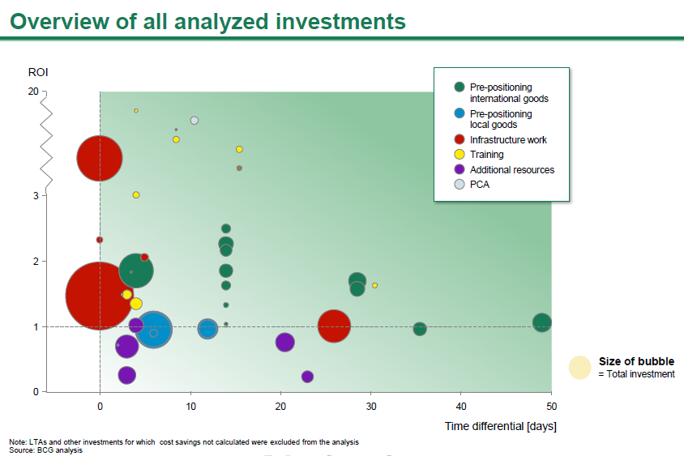

Slide 23
