Slide 1



INFORMATION MANAGEMENT
Is it guiding strategic analysis and supporting operations?
Perspectives from the field, Syria
Make sure you are connected to the audio:
  Click on the box with the headphones icon for “Call Using Computer”.
  If you don’t immediately see the Audio Connection box in front of you, go to the Quick Start tab and find it there.
If your computer audio is not working during the event, you can also listen by phone instead.
Dial +1-650-429-3300 or find the global call-in number for your location at: www.humanitarianresponse.info/system/files/documents/files/Webex%20Global%20call-in%20numbers.pdf
Access code: 647 382 433
In case you are unable to connect to the event, a non-interactive live stream is available as a back-up at http://youtu.be/V23R1nUoWeg
All webinar recordings are available on the website: www.humanitarianresponse.info/topics/transformative-agenda
The first webinar will start at 11:00, Geneva-time
The second webinar will start at 16:00, Geneva-time

Slide 2
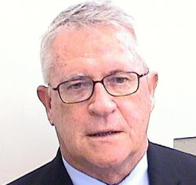

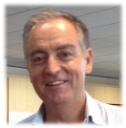
INFORMATION MANAGEMENT
Is it guiding strategic analysis and supporting operations?
Perspectives from the field, Syria
Speakers
Mr. MATHIEU ROUQUETTE,
Representative, Syria INGO Regional Forum (SIRF) &
Co-chair, Syria Information Management and Assessments Working Group (SIMAWG)
Mr. KEVIN KENNEDY
Regional Humanitarian Coordinator, Whole of Syria
Facilitator
PANOS MOUMTZIS
Director, IASC Senior Transformative Agenda Implementation Team (STAIT)
LIVE STREAM ON: http://youtu.be/V23R1nUoWeg

Slide 3
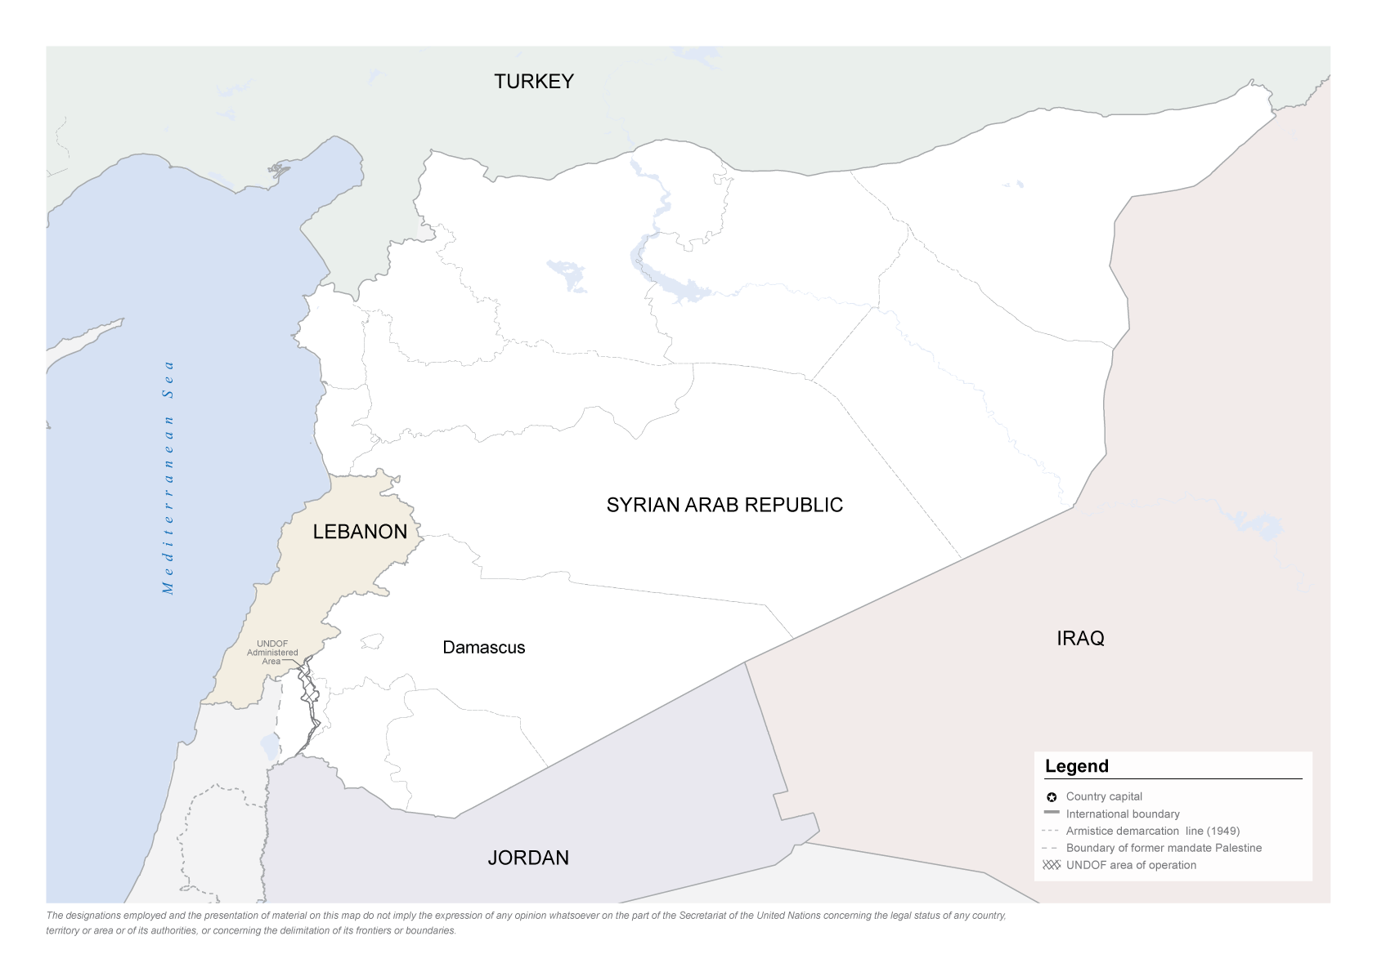

LIVE STREAM ON: http://youtu.be/V23R1nUoWeg

Slide 4
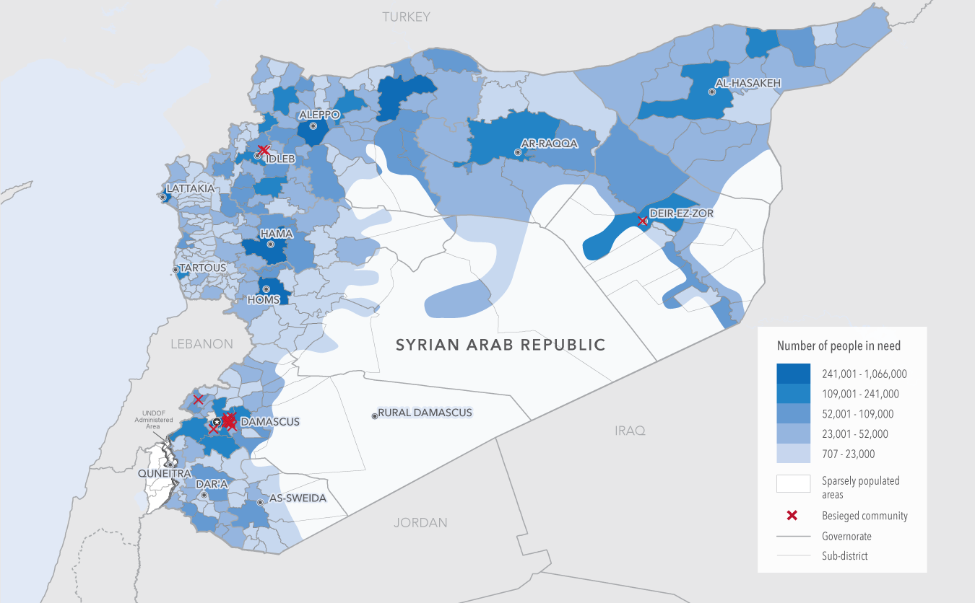
LIVE STREAM ON: http://youtu.be/V23R1nUoWeg

Slide 5
INFORMATION MANAGEMENT WEBINAR
- A history of fragmentation: a siloed response
- The Whole-of-Syria approach: a new collective vision for the response
- Immediate achievements: the 2015 SRP and 2016 HNO
- The critical role of SIRF: a platform for collective engagement
- Transformative Agenda 2.0: institutionalising NGO Fora
- Sociology of Information Management: how the coordination architecture manages its own information
- Out of the collective: key actors not on the radar of the response
Some acronyms:
HNO
Humanitarian Needs Overview
HCT
Humanitarian Country Team
SIMAWG
Syria IM and Assessments Working Group
LIVE STREAM ON: http://youtu.be/V23R1nUoWeg

Slide 6





INFORMATION MANAGEMENT WEBINAR
Information management capacity
Relationship building
Analysis skills
Role of NGOs
IM support mechanisms: IMMAP, REACH, JIPS and ACAPS
LIVE STREAM ON: http://youtu.be/V23R1nUoWeg

Slide 7
INFORMATION MANAGEMENT WEBINAR
Macro efficiency: better IM, better response
Upstream Vs. Downstream: IM improved upstream, HPC related planning and programming, what about downstream response delivery?
Sensitivity of information sharing: targeting of humanitarian staff & facilities
- The catch 22: I’m not sharing if you’re not useful – I’m not useful if you’re not sharing
LIVE STREAM ON: http://youtu.be/V23R1nUoWeg

Slide 8
INFORMATION MANAGEMENT WEBINAR
Improving granularity: making information sharing useful and impactful
Getting there: making IM relevant for operational coordination
The role of Donors: coordinating the funding of IM initiatives
LIVE STREAM ON: http://youtu.be/V23R1nUoWeg

Slide 9
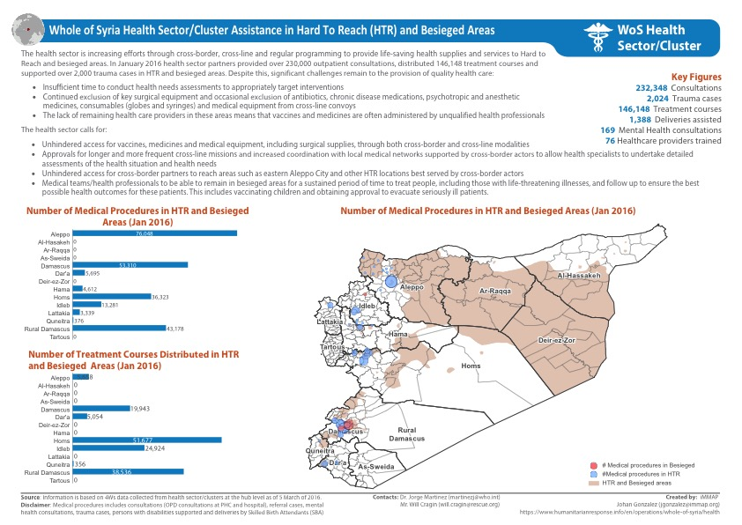
LIVE STREAM ON: http://youtu.be/V23R1nUoWeg

Slide 10
LIVE STREAM ON: http://youtu.be/V23R1nUoWeg

