Slide 1
Webinar series
Wednesday 26 April & 10 May 2017
Humanitarian Development Nexus!
What is the New Way of Working?
Practical examples
PART 1 & 2
Senior Transformative Agenda Implementation Team
STAIT - Supporting humanitarian leaders in the field to deliver aid better.
Created by the Emergency Directors` Group in 2013

Slide 2
Welcome to the webinar!
Humanitarian Development Nexus! What is the New Way of Working? Practical examples
To join:
Make sure you are connected to the audio. Click on the box with the headphones icon for “Call Using Computer”. If you don’t immediately see the Audio Connection box in front of you, go to the Quick Start tab and find it there.
If your computer audio is not working during the event, you can also listen by phone instead. Dial +1-650-429-3300 and type in the access code 641-389-034. If you do not want to call an international (US) number, you can find the global call-in number for your location at the following link. The access code remains the same (641-389-034): www.humanitarianresponse.info/system/files/documents/files/Webex%20Global%20call-in%20numbers.pdf
In case you are unable to connect to the event, a non-interactive live stream is available as a back-up at https://www.youtube.com/watch?v=Yb4jnelUoEk&feature=youtu.be
All webinar recordings are available on the website: www.deliveraidbetter.org
STAIT - Supporting humanitarian leaders in the field to deliver aid better.
Created by the Emergency Directors` Group in 2013

Slide 3
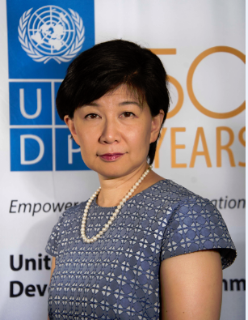
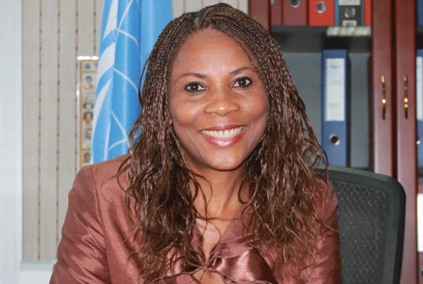
Speakers
Izumi Nakamitsu
Assistant Secretary-General and Assistant Administrator, Crisis Response Unit, UNDP HQ/NY
Ahunna Eziakonwa-Onochie Resident & Humanitarian Coordinator, Ethiopia
Panos Moumtzis
STAIT Team Leader
Webinar facilitator
Humanitarian Development Nexus! What is the New Way of Working? Practical examples

Slide 4
What is the new way of working all about?
Is it just a new name?
How does it look like at the field level?
Photo credit: OCHA
Humanitarian Development Nexus! What is the New Way of Working? Practical examples

Slide 5
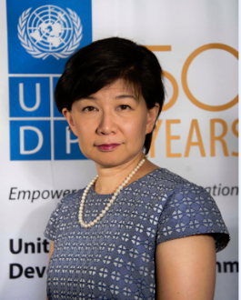
The New Way of Working (NWoW)
Commitment to Action signed by eight agencies, the World Bank and IOM at the World Humanitarian Summit
The NWoW can be described, in short, as working over multiple years, based on the comparative advantage of a diverse range of actors, including those outside the UN system, towards collective outcomes.
Izumi Nakamitsu
Assistant Secretary-General And Assistant Administrator, Crisis Response Unit, UNDP
Humanitarian Development Nexus! What is the New Way of Working? Practical examples

Slide 6
The issue is old, the approach is new.
Five steps approaches at field level:
A joint analysis,
A joint vision,
A joined-up planning and programming,
An empowered leadership and coordination,
New modalities of financing.
Field examples: Sudan, Burkina Faso, Lebanon
Izumi Nakamitsu
Assistant Secretary-General And Assistant Administrator, Crisis Response Unit, UNDP
Humanitarian Development Nexus! What is the New Way of Working? Practical examples

Slide 7
What are the practical steps from a leadership field perspective Resident coordinators and Humanitarian coordinators should be taking to bring closer the humanitarian / development nexus?
Photo credit: OCHA
Humanitarian Development Nexus! What is the New Way of Working? Practical examples

Slide 8
Practical Steps (1/2)
Aligning of planning cycles
Close coordination and dialogue between the HCT and UNCT
Leveraging the Grand Bargain at Country Level
Izumi Nakamitsu
Assistant Secretary-General And Assistant Administrator, Crisis Response Unit, UNDP
Humanitarian Development Nexus! What is the New Way of Working? Practical examples

Slide 9
Practical Steps (2/2)
4. “People Pipeline”, H-D Advisers, and political support
5. Field driven with coordinated support from Headquarters
Izumi Nakamitsu
Assistant Secretary-General And Assistant Administrator, Crisis Response Unit, UNDP
Humanitarian Development Nexus! What is the New Way of Working? Practical examples

Slide 10
What are the steps you took at the country level in your capacity as RC/HC to bring closer the humanitarian short term and development longer term support to the affected people?
Humanitarian Development Nexus! What is the New Way of Working? Practical examples

Slide 11
Humanitarian Development Nexus! What is the New Way of Working? Practical examples

Slide 12
5 Steps taken in Ethiopia
Understand the development context and identify nexus opportunities – where the risks & vulnerabilities lie, the needs to be addressed & how resources flow.
2. Joint visioning, analysis, messaging & advocacy between Humanitarian & Development partners.
3. Maximise opportunities for complementary Humanitarian & Development programming – 1 Wash Programme & use of National System
Ahunna Eziakonwa-Onochie Resident & Humanitarian Coordinator, Ethiopia
Humanitarian Development Nexus! What is the New Way of Working? Practical examples

Slide 13
5 Steps taken in Ethiopia
Bridging Humanitarian & Development Partners - Coordination architecture & identify creative ways to ensure cross-pollination.
Ensure a balanced & well informed Humanitarian Field Leaders - Humanitarian Cluster Coordinators are grounded with sound knowledge of the local development context.
Ahunna Eziakonwa-Onochie Resident & Humanitarian Coordinator, Ethiopia
Humanitarian Development Nexus! What is the New Way of Working? Practical examples

Slide 14
Based on your Ethiopia experience, what are the lessons learned that can be helpful for other operations? What would you have done differently?
Photo credit: OCHA
Humanitarian Development Nexus! What is the New Way of Working? Practical examples

Slide 15
5 Lessons Learned (1/2)
Ahunna Eziakonwa-Onochie Resident & Humanitarian Coordinator, Ethiopia
National leadership & ownership & use of national systems is central to gaining trust and achieving impact.
Integrated programming & integrated architecture important for resource efficiency & effectiveness and common visioning.
Capitalise on opportunities & momentum to improve existing response systems in the spirit of the New Way of Working.
Humanitarian Development Nexus! What is the New Way of Working? Practical examples

Slide 16
5 Lessons Learned (2/2)
Ahunna Eziakonwa-Onochie Resident & Humanitarian Coordinator, Ethiopia
Think creatively – design the appropriate structures. Architecture is key!
Innovative funding options that support the nexus - incentives for actors to change mindset
Crises often generate opportunities & momentum to improve existing response systems in the spirit of the New Way of Working
Humanitarian Development Nexus! What is the New Way of Working? Practical examples

Slide 17
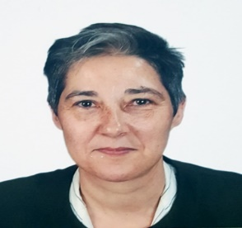
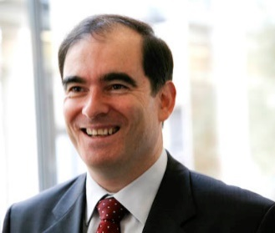
Marta Ruedas
Resident & Humanitarian Coordinator, Sudan
John Ging
OCHA Director of Operations
Panos Moumtzis
STAIT Team Leader
Webinar facilitator
Senior Transformative Agenda Implementation Team (STAIT)
Humanitarian Development Nexus! What is the New Way of Working? Practical examples

Slide 18
Panos Moumtzis
STAIT Team Leader
Webinar facilitator
How is the “new way of working” any different from previous efforts to link humanitarian and development operations?
How can colleagues in the field implement the “new way of working” in operations….
…..and what can agency and NGO headquarters do to support field colleagues?
Photo credit: OCHA
Humanitarian Development Nexus! What is the New Way of Working? Practical examples

Slide 19
Why have efforts to link relief and development not worked in the past?
Deficit of development action in recurring and protracted crises. It is often possible but under-resourced
Humanitarian action alone is not enough to reduce needs, vulnerability and risks and it cannot address the structural deficits and root causes that underpin protracted crises
↓
Short-, medium- and longer-term support needs to be provided to vulnerable people concurrently, wherever possible (i.e. in a ‘contiguum’)
John Ging
OCHA Director of Operations
Photo credit: OCHA
Humanitarian Development Nexus! What is the New Way of Working? Practical examples

Slide 20
A historic opportunity to strengthen the humanitarian-development nexus
SDGs’ commitment to “reach those furthest behind first” and reduce risks and vulnerabilities
New UNDAF guidelines include the need for development partners to be more risk-informed and adaptable to risks and changing priorities on the ground
World Bank is making significant progress in stepping up support to fragile and conflict affected states
NWOW has received widespread support from the UN, donors, affected States, IFIs and others since the World Humanitarian Summit (WHS)
John Ging
OCHA Director of Operations
Humanitarian Development Nexus! What is the New Way of Working? Practical examples

Slide 21
Steps to implement the new way of working
Joint analysis of needs, vulnerabilities and risks, and of capacities to address them
Develop collective outcomes around reducing needs, vulnerabilities and risk & identify activities needed to achieve them, across the humanitarian-development nexus
Determine what would support more effective alignment of short, medium and longer-term programmes and financing to lead to better results for people, in a way that preserves humanitarian principles
John Ging
OCHA Director of Operations
Humanitarian Development Nexus! What is the New Way of Working? Practical examples

Slide 22
How can HQ support the field in implementing the NWOW?
Given their respective functions of supporting coordination, planning and pooled funding, OCHA and UNDP are discussing how to best support OCHA and RCOs in the field
Headquarters of operational humanitarian and development organizations can support field colleagues by:
encouraging more effective collaboration and coordination between their humanitarian and development teams, to ensure more coherent alignment/layering of short, medium and long term programming targeting the most vulnerable people;
ensuring data and analysis on needs, vulnerability and risk is incorporated in development planning processes;
supporting the implementation of earlier, more risk-informed and risk-tolerant, and more flexible/context-adaptable development programming targeting the most vulnerable people
supporting the implementation of humanitarian programmes that ‘leave something behind’ and encourage local ownership and capacity
John Ging
OCHA Director of Operations
Humanitarian Development Nexus! What is the New Way of Working? Practical examples

Slide 23
Panos Moumtzis
STAIT Team Leader
Webinar facilitator
Does the Humanitarian-Development nexus take into account the political/peace/stability context?
In conflict situations, how can we (including development actors) work in non-government controlled areas?
Photo credit: OCHA
Humanitarian Development Nexus! What is the New Way of Working? Practical examples

Slide 24
How the humanitarian-development nexus takes into account peace/stability
Better responding to people’s needs requires more systematic conflict analysis and understanding of the political context
The NWOW acknowledges that collective outcomes can, in many cases, contribute to sustaining peace but that humanitarian action cannot be driven by a political end or purpose – the main purpose of humanitarian action remains to address life-saving needs and alleviate suffering
Coherence and coordination within the UN system in support of peace consolidation is grounded in the IAP policy (Integrated Assessment and Planning policy)
John Ging
OCHA Director of Operations
Humanitarian Development Nexus! What is the New Way of Working? Practical examples

Slide 25
The humanitarian-development nexus in non-government controlled areas
Some NGOs have found ways to continue to do community-based development in such environments. However, because of their mode of operation and relationship with governments who may be party to a conflict, many development actors will not be able to be physically present or pursue interventions at scale in areas outside of government control
The challenge of working in non-state controlled areas illustrates the need for arrangements that are appropriate to the context and fully respect humanitarian principles
John Ging
OCHA Director of Operations
Humanitarian Development Nexus! What is the New Way of Working? Practical examples

Slide 26
Panos Moumtzis
STAIT Team Leader
Webinar facilitator
In the Sudan context, what steps did you take to bring closer the humanitarian and development actors and programmes?
Humanitarian Development Nexus! What is the New Way of Working? Practical examples

Slide 27
New way of working in Sudan (2/3)
2. Enhance durable solutions
HCT protracted Displacement Strategy
Multi-sector, integrated approach
2 Joint IDP Profiling Service (JIPS) missions and 1 Global Cluster on Early Recovery (GCER) durable solutions mission
Funding from UN / World Bank Partnership Trust Fund for Humanitarian Development Peace (HDP) Initiative
Durable solutions Working Group, under the HCT/UNCT
Profiling / methodology coordinator in the RC/HC office
Marta Ruedas
Resident & Humanitarian Coordinator, Sudan
Humanitarian Development Nexus! What is the New Way of Working? Practical examples

Slide 28
New way of working in Sudan (3/3)
Marta Ruedas
Resident & Humanitarian Coordinator, Sudan
3. Coherent financing in line with NWoW and the Grand Bargain
Advocacy with donor community on more flexible financing, including missions (not resource mobilization missions)
Joint humanitarian and development donors meetings
Financing mission composed of OECD, Multi-Partner Trust Fund (MPTF) and OCHA
Humanitarian Development Nexus! What is the New Way of Working? Practical examples

Slide 29
Panos Moumtzis
STAIT Team Leader
Webinar facilitator
What are your lessons learned so far from the new way of working?
Humanitarian Development Nexus! What is the New Way of Working? Practical examples

Slide 30
LESSONS LEARNED (1/2)
Marta Ruedas
Resident & Humanitarian Coordinator, Sudan
Be courageous: challenge ourselves and leave our comfort zone
Drastic change and measures will not help
Others actors (donors, INGOs…) have already started working differently, often outside UN led coordination
Need to be ambitious and innovative
Humanitarian Development Nexus! What is the New Way of Working? Practical examples

Slide 31
LESSONS LEARNED (2/2)
Marta Ruedas
Resident & Humanitarian Coordinator, Sudan
Working toward collective outcomes (i.e. HRP/UNDAF)
Establish coordination structures to enable organic shift
Agree with donors at country level on the Grand Bargain commitments and shifting to more flexible, multi-annual funding
Humanitarian Development Nexus! What is the New Way of Working? Practical examples

Slide 32
Senior Transformative Agenda Implementation Team
What is STAIT?
The Senior Transformative Agenda Implementation Team (STAIT) was created by the Emergency Directors’ Group (EDG) in December 2013.
Its purpose is to provide peer support to Humanitarian Coordinators (HCs) and Humanitarian Country Teams (HCTs) to strengthen the effectiveness of humanitarian response in the field.
The team reports to the EDG, is hosted by OCHA, and supported administratively by UNDP.
Contact us: STAIT@un.org ; www.deliveraidbetter.org
All webinar recordings are available on:
www.youtube.com; www.humanitarianresponse.info/topics/transformative-agenda

