Slide 1
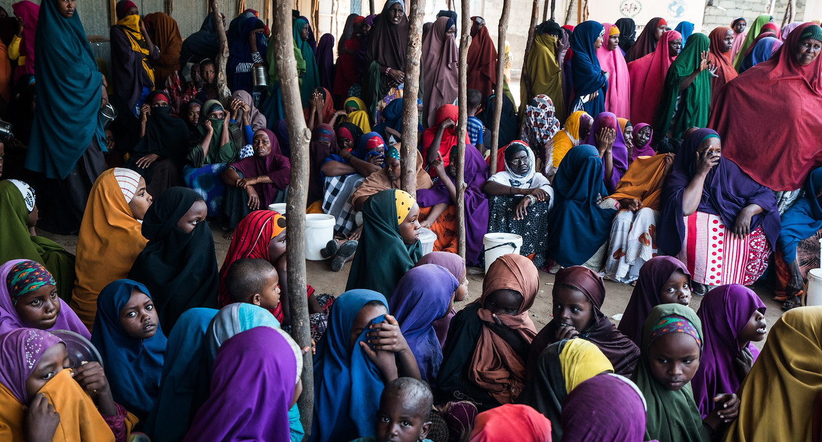
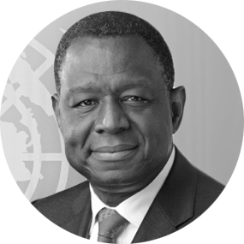
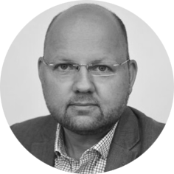
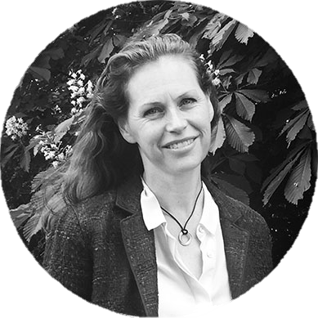
Peer 2 Peer Support is formerly known as STAIT
Dr. Babatunde Osotimehin Under Secretary General and Executive Director of UNFPA
Peter Lundberg
Deputy Humanitarian Coordinator, Nigeria
Ingrid Macdonald
Director, P2P Support
WEBINAR FACILITATOR
P2P Support – For Humanitarian Leaders in the Field
Created by the Emergency Directors’ Group (EDG) in 2013

Slide 2
Peer 2 Peer Support is formerly known as STAIT
Why is collective leadership by the HC and HCT critical for ensuring effective response to Gender Based Violence in field operations?
P2P Support – For Humanitarian Leaders in the Field
Created by the Emergency Directors’ Group (EDG) in 2013

Slide 3
Peer 2 Peer Support is formerly known as STAIT
Why is collective leadership by the HC and HCT important?
GBV is not just technical – it requires SENIOR leadership
GBV is not only a one agency/sub-cluster issue – it requires everyone to work together at all levels on:
Prevention and mitigating risks
Ensuring that survivors have access to life-saving care.
SGBV is one of the four mandatory priorities of the new HCT TORs
GBV is a part of the IASC Principals commitment to the Centrality of Protection in Humanitarian Action – a core responsibility of HC/HCTs.
GBV is a life-saving criteria for CERF proposals.
Dr. Babatunde Osotimehin
Under Secretary General and Executive Director of UNFPA
P2P Support – For Humanitarian Leaders in the Field
Created by the Emergency Directors’ Group (EDG) in 2013

Slide 4
Peer 2 Peer Support is formerly known as STAIT
Role of leadership: advocacy, visibility and accountability
Conduct ADVOCACY
Promote inclusion of GBV requirements in humanitarian appeals and donor initiatives
Promote agreed advocacy messages with high-level stakeholders
Give VISIBILITY to the issue
Have regular items on GBV priorities at HCT meetings
Ensure GBV is visible in response planning (HNO/HRP).
Promote mutual ACCOUNTABILITY
Include commitments to GBV prevention, mitigation and response in HCT compacts, strategies and work plans.
Dr. Babatunde Osotimehin
Under Secretary General and Executive Director of UNFPA
P2P Support – For Humanitarian Leaders in the Field
Created by the Emergency Directors’ Group (EDG) in 2013

Slide 5
Peer 2 Peer Support is formerly known as STAIT
What can Humanitarian Coordinators and HCTs do to address popular misconceptions concerning GBV prevention and response?
P2P Support – For Humanitarian Leaders in the Field
Created by the Emergency Directors’ Group (EDG) in 2013

Slide 6
Peer 2 Peer Support is formerly known as STAIT
Misconceptions on GBV and what HCs and HCTs can do
Misconception
Reality and Action
Dr. Babatunde Osotimehin
Under Secretary General and Executive Director of UNFPA
Data or “proof” that GBV is happening is necessary to justify response or funding.
GBV is not a priority compared to other sectors.
GBV prevention and response can only be done by GBV specialists.
Assume GBV is taking pace and support action to mitigate risk and reduce harm.
Play a role in underscoring that GBV is life – saving.
Underscore the need for all actors to treat GBV as life threatening and minimize GBV risk across all sectoral interventions.
P2P Support – For Humanitarian Leaders in the Field
Created by the Emergency Directors’ Group (EDG) in 2013

Slide 7
Peer 2 Peer Support is formerly known as STAIT
As a Deputy Humanitarian Coordinator, what concrete steps have you and the HCT taken to address GBV across the response?
P2P Support – For Humanitarian Leaders in the Field
Created by the Emergency Directors’ Group (EDG) in 2013

Slide 8
Peer 2 Peer Support is formerly known as STAIT
Prioritizing GBV in coordination and response
From start: Recognised prevalence & risk of GBV
In L3 scale up: Prioritised gender equality & response
Set-up: GBV sub-sector groups in 4 conflict affected states focused on coordination & operational support
Set up: Abuja (capital) GBV sub-sector group focused on policy and strategy
Ensured: Joint government co-leadership
Peter Lundberg
Deputy Humanitarian Coordinator, Nigeria
P2P Support – For Humanitarian Leaders in the Field
Created by the Emergency Directors’ Group (EDG) in 2013

Slide 9
Peer 2 Peer Support is formerly known as STAIT
Nigeria: Fostering collaborative efforts & approaches
Enhanced accountability – eg, police, judicial systems
Prioritised joint UN, NGO & government life-saving interventions eg. GBV case management, material & clinical assistance
Strengthened community protection systems eg. Child networks
Integrated recovery within GBV response eg. Livelihood initiatives
Enhanced capacity of frontline service providers
Established and strengthened framework for PSEA
Peter Lundberg
Deputy Humanitarian Coordinator, Nigeria
P2P Support – For Humanitarian Leaders in the Field
Created by the Emergency Directors’ Group (EDG) in 2013

Slide 10
Peer 2 Peer Support is formerly known as STAIT
What steps have you taken to ensure that GBV is integrated across the different sectors?
P2P Support – For Humanitarian Leaders in the Field
Created by the Emergency Directors’ Group (EDG) in 2013

Slide 11
Peer 2 Peer Support is formerly known as STAIT
Integrating GBV across response
Implementation of GBV prevention and mitigation strategies, eg. Referral pathways & SOPs;
Built resilience through community based systems, eg. Community outreach and dialogue
Provided support to local and national capacity for lasting solutions
Peter Lundberg
Deputy Humanitarian Coordinator, Nigeria
P2P Support – For Humanitarian Leaders in the Field
Created by the Emergency Directors’ Group (EDG) in 2013

Slide 12
Peer 2 Peer Support is formerly known as STAIT
Practical steps for sectors
Appoint GBV focal points in sector groups
Incorporate GBV within sector activities
Develop user-friendly, context appropriate GBV mainstreaming tools
Conduct GBV mainstreaming trainings with humanitarian staff
Peter Lundberg
Deputy Humanitarian Coordinator, Nigeria
P2P Support – For Humanitarian Leaders in the Field
Created by the Emergency Directors’ Group (EDG) in 2013

Slide 13
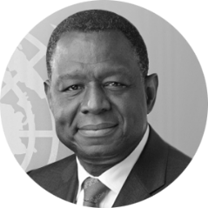
Peer 2 Peer Support is formerly known as STAIT
IN MEMORY
Dr. Babatunde Osotimehin Under Secretary General and Executive Director of UNFPA
P2P Support – For Humanitarian Leaders in the Field
Created by the Emergency Directors’ Group (EDG) in 2013

Slide 14
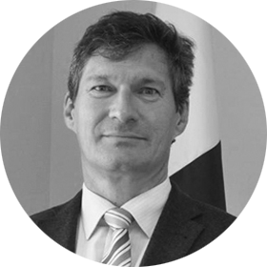
Peer 2 Peer Support is formerly known as STAIT
Kate Moger
Deputy Regional Director for West Africa, IRC
Neil Buhne
Resident and Humanitarian Coordinator, Pakistan
Ingrid Macdonald
Director, P2P Support
WEBINAR FACILITATOR
P2P Support – For Humanitarian Leaders in the Field
Created by the Emergency Directors’ Group (EDG) in 2013

Slide 15
Peer 2 Peer Support is formerly known as STAIT
What steps has IRC taken to institutionalise GBV prevention and response globally and locally? How has it contributed to collective response?
P2P Support – For Humanitarian Leaders in the Field
Created by the Emergency Directors’ Group (EDG) in 2013

Slide 16
Peer 2 Peer Support is formerly known as STAIT
IRC’s steps: internal policy & response
Provides GBV survivors with lifesaving services
Builds GBV sector capacity to enhance response when crisis hits
Prioritises gender and GBV in institutional policies
Gender equality commitment in new IRC strategy
Outcomes and evidence framework aims to reduce the gender gap
Gender and GBV prioritised in country strategies
Ex. 6/8 countries in West Africa, Sahel and Central Africa prioritize GBV in strategies
Kate Moger
Deputy Regional Director for West Africa, IRC
P2P Support – For Humanitarian Leaders in the Field
Created by the Emergency Directors’ Group (EDG) in 2013

Slide 17
Peer 2 Peer Support is formerly known as STAIT
IRC’s steps: Global advocacy
Ensure GBV is prioritised in the global advocacy agenda
Call to Action on protection from GBV in Emergencies: global platform of 66 partners
Seek dedicated commitments on women and girls in global processes, eg. GBV is a core commitment of the World Humanitarian Summit.
BUT: Must ensure that high level commitments result in concrete change for women, girls and GBV survivors
Kate Moger
Deputy Regional Director for West Africa, IRC
P2P Support – For Humanitarian Leaders in the Field
Created by the Emergency Directors’ Group (EDG) in 2013

Slide 18
Peer 2 Peer Support is formerly known as STAIT
What can NGO country representatives do to prioritize GBV prevention and response across collective humanitarian efforts?
P2P Support – For Humanitarian Leaders in the Field
Created by the Emergency Directors’ Group (EDG) in 2013

Slide 19
Peer 2 Peer Support is formerly known as STAIT
Prioritize GBV across collective efforts
Advocate to ensure humanitarian leadership is accountable for implementing current commitments:
Call to Action on Protection from GBV in Emergencies
Real-Time Accountability Partnership
eg. Include commitments to GBV prevention, mitigation and response in the HC-ERC Compact.
GBV coordination bodies in field and globally used for advocacy
eg. Cameroon HCT selected GBV as a key protection issue in their strategy
- Implement existing minimum standards for reducing the risks of GBV in emergencies:
Support roll-out of the updated IASC GBV Guidelines
Kate Moger
Deputy Regional Director for West Africa, IRC
P2P Support – For Humanitarian Leaders in the Field
Created by the Emergency Directors’ Group (EDG) in 2013

Slide 20
Peer 2 Peer Support is formerly known as STAIT
What steps have you and the Humanitarian Country Team taken in Pakistan to prioritise GBV prevention, response and mitigation?
P2P Support – For Humanitarian Leaders in the Field
Created by the Emergency Directors’ Group (EDG) in 2013

Slide 21
Peer 2 Peer Support is formerly known as STAIT
HC & HCT leadership on GBV
Advocacy / visibility / accountability
HSP has a GBV section since 2014
Linking clusters in preventing, mitigating and referral of GBV cases
Gender & GBV training by all clusters
Including female staff & mandatory 30% female mission members strengthens disaggregated data & assessment, analysis & response to GBV survivors & women
Collaboration with the NDMA (government) Gender and Child Cell
Interagency and civil society forum of GHTF highlight GBV concerns
Donor briefs raise GBV concerns
Neil Buhne
Resident and Humanitarian Coordinator, Pakistan
P2P Support – For Humanitarian Leaders in the Field
Created by the Emergency Directors’ Group (EDG) in 2013

Slide 22
Peer 2 Peer Support is formerly known as STAIT
What lessons could be helpful for other operations, including addressing cultural challenges?
P2P Support – For Humanitarian Leaders in the Field
Created by the Emergency Directors’ Group (EDG) in 2013

Slide 23
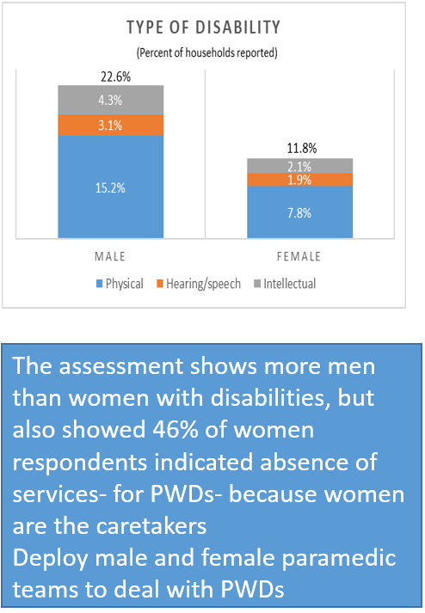
Peer 2 Peer Support is formerly known as STAIT
Way Forward in GBV mitigation
Contextualize:
Respect local tradition, norms and values
Collect location specific data
Advocate and adapt implementation:
Mix hard and soft activities in culturally sensitive and appropriate manner
Look for opportunities in every plan, budget, mission, and action to prioritise GBV
Build sustainability through local committees where men and women define their own protection and empowerment solutions
Neil Buhne
Resident and Humanitarian Coordinator, Pakistan
P2P Support – For Humanitarian Leaders in the Field
Created by the Emergency Directors’ Group (EDG) in 2013

Slide 24
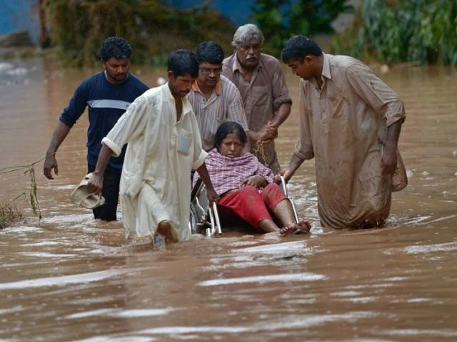
Peer 2 Peer Support is formerly known as STAIT
Way Forward in GBV mitigation
Support diverse coordination networks
Build quantitative & qualitative assessment capacity for GBV analysis, adapted activities and monitoring
Ensure male and female staff balance
Utilise the humanitarian development continuum to capture good practices and address problems in transition programming
Neil Buhne
Resident and Humanitarian Coordinator, Pakistan
SGBV risks & vulnerabilities cannot be understood only with quantitative analysis- we also need qualitative data analysis
P2P Support – For Humanitarian Leaders in the Field
Created by the Emergency Directors’ Group (EDG) in 2013

