Slide 1
Peer 2 Peer Support is formerly known as STAIT
Webinar series
Wednesday 13 September 2017
Local actors as equal and strategic partners?
Field perspectives
P2P Support – For Humanitarian Leaders in the Field
Created by the Emergency Directors’ Group (EDG) in 2013

Slide 2
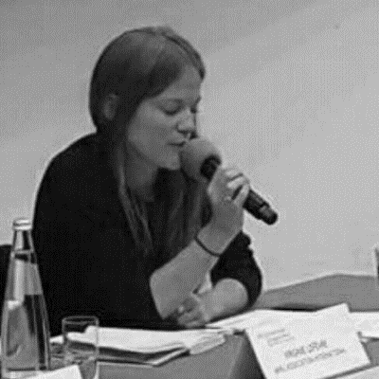
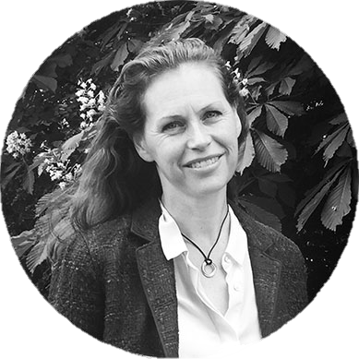
Peer 2 Peer Support is formerly known as STAIT
Ramesh Rajasingham
Deputy Regional Humanitarian Coordinator for the Syria Crisis
Halima Ali Adan
GBV Sub-Cluster Coordinator, Somalia
Virginie Lefèvre
Program and Partnerships Coordinator, Amel Association International, Lebanon
Ingrid Macdonald
Director, P2P Support
WEBINAR FACILITATOR
P2P Support – For Humanitarian Leaders in the Field
Created by the Emergency Directors’ Group (EDG) in 2013

Slide 3
Peer 2 Peer Support is formerly known as STAIT
What steps have been taken to support local actors as equal, principled and strategic partners?
P2P Support – For Humanitarian Leaders in the Field
Created by the Emergency Directors’ Group (EDG) in 2013

Slide 4
Peer 2 Peer Support is formerly known as STAIT
Context
Evolution of Syrian NGOs
Volume and nature of humanitarian operation
Areas of operation
Status of local NGOs
P2P Support – For Humanitarian Leaders in the Field
Created by the Emergency Directors’ Group (EDG) in 2013

Slide 5
Peer 2 Peer Support is formerly known as STAIT
Engagement & inclusion of local NGOs in coordination
Pre- UNSCR 2165 (July 2014)
Coordination structure
Turkish Red Crescent (Kizilay)
2014 roll out of IASC humanitarian coordination
Syrian Networks
Humanitarian Liaison Group
Inter-cluster coordination
Cluster coordination and leadership
Humanitarian Pooled fund
P2P Support – For Humanitarian Leaders in the Field
Created by the Emergency Directors’ Group (EDG) in 2013

Slide 6
Peer 2 Peer Support is formerly known as STAIT
What are some lessons learned in areas such as representation, risk management and principled humanitarian action?
P2P Support – For Humanitarian Leaders in the Field
Created by the Emergency Directors’ Group (EDG) in 2013

Slide 7
Peer 2 Peer Support is formerly known as STAIT
Assets and Challenges
ASSETS
Social stake
AAP
Information
Expertise
Diaspora
Service delivery
Innovation – 2 way
Non-traditional funding
CHALLENGES
Limits of humanitarian frameworks & principles
Risk & duty of care
National & local authorities
Square pegs and round holes
FUNDING!
P2P Support – For Humanitarian Leaders in the Field
Created by the Emergency Directors’ Group (EDG) in 2013

Slide 8
Peer 2 Peer Support is formerly known as STAIT
Outstanding Questions
Realizing the Grand Bargain commitments
Humanitarian principles
Risk and duty of care
Legal status
Engaging in longer term national processes
P2P Support – For Humanitarian Leaders in the Field
Created by the Emergency Directors’ Group (EDG) in 2013

Slide 9
Peer 2 Peer Support is formerly known as STAIT
How have local actors ensured their voice and expertise are part of the collective humanitarian response, including in decision-making?
P2P Support – For Humanitarian Leaders in the Field
Created by the Emergency Directors’ Group (EDG) in 2013

Slide 10
Peer 2 Peer Support is formerly known as STAIT
How local & national NGOs can ensure that their perspectives inform the response?
- Networking and coordination between local actors Eg: Local NGO Forum in Lebanon - Including local actors in all coordination mechanisms Eg: Mapping of the committees by the LNGOs - Using the expertise of local actors at the sectoral level Eg: Local NGO sectoral focal points - Identifying allies to share LNGOs voices Eg: Coordination between the Local NGO Forum and the Lebanon Humanitarian INGO Forum in Lebanon
P2P Support – For Humanitarian Leaders in the Field
Created by the Emergency Directors’ Group (EDG) in 2013

Slide 11
Peer 2 Peer Support is formerly known as STAIT
Contribution of the other parts of the system to inclusion
- Ensuring fair representation at the HCT Eg: Representation of the Lebanese NGOs (HCT – Lebanon) - Supporting the inclusion of LNGOs at the HCT Eg: INGOs role in the revision of the HCT TORs in Lebanon.
P2P Support – For Humanitarian Leaders in the Field
Created by the Emergency Directors’ Group (EDG) in 2013

Slide 12
Peer 2 Peer Support is formerly known as STAIT
What are some lessons learned in areas such as representation, participation, language & funding?
P2P Support – For Humanitarian Leaders in the Field
Created by the Emergency Directors’ Group (EDG) in 2013

Slide 13
Peer 2 Peer Support is formerly known as STAIT
1. Language is not always a barrier: our approach needs to adapt to the local context. Example: Regional coordination groups in Lebanon, using Arabic. 2. Local NGOs can cope with limited liaison resources through coordination and networking. Example: Local NGO Forum Focal Point in Lebanon 3. Local and national actors require fair and sustainable relationships with their international counterparts Example: Partnerships between local and international NGOs 4. Access to direct funding is a driver of localization Example: Lebanon Humanitarian Fund
P2P Support – For Humanitarian Leaders in the Field
Created by the Emergency Directors’ Group (EDG) in 2013

Slide 14
Peer 2 Peer Support is formerly known as STAIT
How have you supported local actors within your GBV sub-cluster, including to facilitate their voice, & support their funding and capacities?
P2P Support – For Humanitarian Leaders in the Field
Created by the Emergency Directors’ Group (EDG) in 2013

Slide 15
Peer 2 Peer Support is formerly known as STAIT
- Enhancing local NGO participation & co-facilitation of clusters
Example: Joint decision-making as co-facilitator; Local actors participating in joint needs assessments
Leveraging resources & strengthening local NGO capacity
Example: Local NGOs represented on the pooled funds advisory boards
Strengthening the Voice of National NGOs in coordination
Example: Somalia Aid Localization Workshop advocating at national & global levels with the UN agencies, INGOs, donors
P2P Support – For Humanitarian Leaders in the Field
Created by the Emergency Directors’ Group (EDG) in 2013

Slide 16
Peer 2 Peer Support is formerly known as STAIT
Recommendations
Conducive space for showcasing innovation at the grassroots level.
Ability to provide tailored capacity building and mentorship to LNGO.
Trainings customized to local context and in the national language.
Concerted effort of LNGO & INGO in social transformation.
Full participation of women required.
Strategic alliance between women & men to advocate women issues.
P2P Support – For Humanitarian Leaders in the Field
Created by the Emergency Directors’ Group (EDG) in 2013

Slide 17
Peer 2 Peer Support is formerly known as STAIT
What are the lessons learned on local actors & respect for women’s rights, inclusivity & addressing GBV?
P2P Support – For Humanitarian Leaders in the Field
Created by the Emergency Directors’ Group (EDG) in 2013

Slide 18
Peer 2 Peer Support is formerly known as STAIT
Local actors have strengths:
*Commitment
*Trust of the community
GBV was taboo but local actors drove a national campaign with religious leaders, the private sector, musicians etc to change this
Rape is now discussed at the household level & survivors/community members are referring cases
Advocate importance of inclusivity of women in political representation at all levels: 24% women quota was organized by local women
P2P Support – For Humanitarian Leaders in the Field
Created by the Emergency Directors’ Group (EDG) in 2013

Slide 19
Peer 2 Peer Support is formerly known as STAIT
Practical steps to address sensitivities
Local actors provide services, eg, safe houses appreciated by the community
Continuous capacity building for LNGOs and local authorities
A shift from seeing women (& other groups exposed to GBV) as victims to seeing them as survivors, actors and agents of change.
Collaboration with the Ministry of Gender, Family Affairs and Human rights who are part of the GBV sub cluster (state level)
Work with men to address GBV in order to change behavior, strengthen community institutions & promote women’s equality and leadership.
P2P Support – For Humanitarian Leaders in the Field
Created by the Emergency Directors’ Group (EDG) in 2013

Slide 20
Peer 2 Peer Support is formerly known as STAIT
Peer 2 Peer Support
What is P2P Support?
Peer 2 Peer Support (P2P Support) is formerly know as STAIT (the Senior Transformative Agenda Implementation Team). It was created by the Emergency Directors’ Group (EDG) in December 2013. Its purpose is to provide direct peer support to Humanitarian Coordinators (HCs) and Humanitarian Country Teams (HCTs) to strengthen the effectiveness of humanitarian response in the field. The team reports to the EDG, is hosted by OCHA, and is administered by UNDP.
Contact us: P2PSupport@un.org; www.deliveraidbetter.org
All webinar recordings are available on:
https://www.youtube.com/channel/UC-tRLCM50a2ihhafscLh8YQ
P2P Support – For Humanitarian Leaders in the Field
Created by the Emergency Directors’ Group (EDG) in 2013

